Slide 1
Lecture 8
Functions of a Random Variable
Functions of Two or More Random Variables.

Slide 2
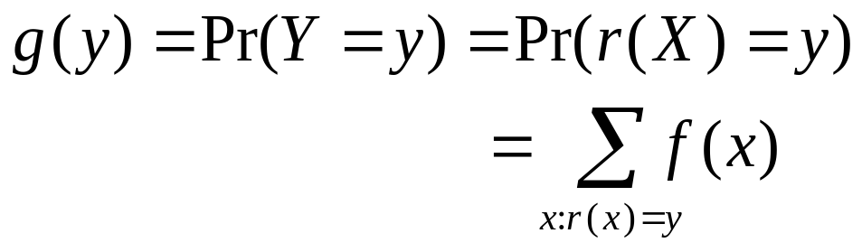
Functions of A Random Variable
Suppose X has a discrete distribution with p.f. f, and Y=r(X), a function of X. The p.f. of Y is:
Notes:
E.g. X takes value among “primary school”, “middle school”, “high school”, “college” and “above college”. Y takes value among “below college”, “college” and “above college”.

Slide 3
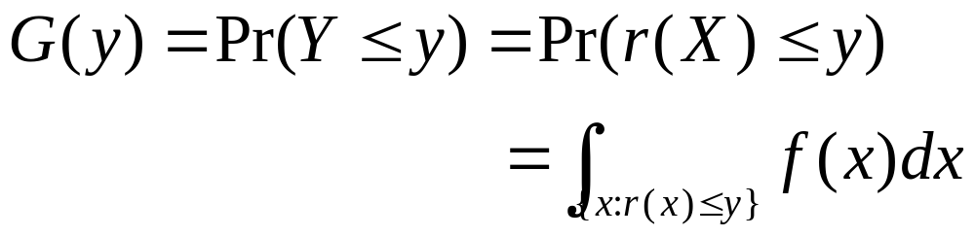
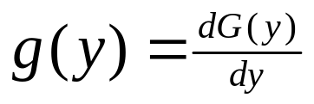
Variable with A Continuous Distribution
Suppose X has a continuous distribution with p.d.f. f, and Y=r(X), a function of X. The d.f. G of Y can be derived as:
If Y also has a continuous distribution, its p.d.f. g can be obtained by
at any y where G is differentiable.
Notes:
X=Monthly Income
(1) Y=1 if Monthly Income<5,000
Y=2 if Monthly Income>=5,000 and <20,000m
Y=3 if Monthly Income>=20,000
(2) Y=Monthly Income – 5,000

Slide 4
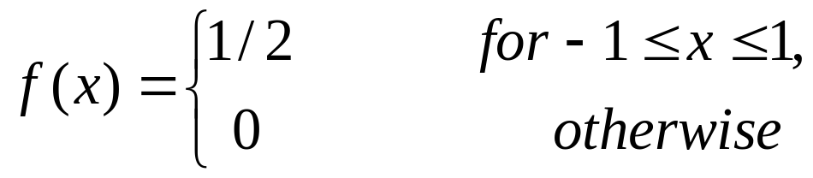

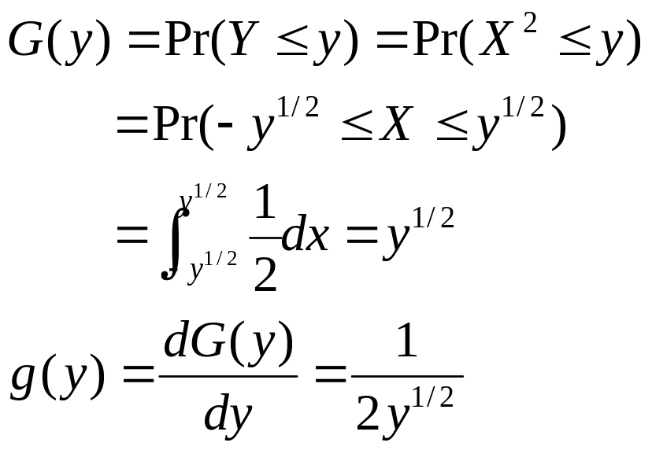
Example
Suppose X has a uniform distribution on (-1,1),
What is the p.d.f for ?
Solution: For 0<y<1,
Notes:
Also focus on domain.

Slide 5
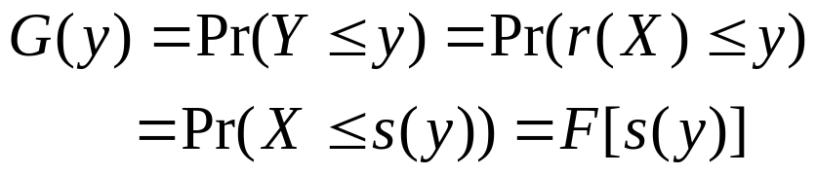
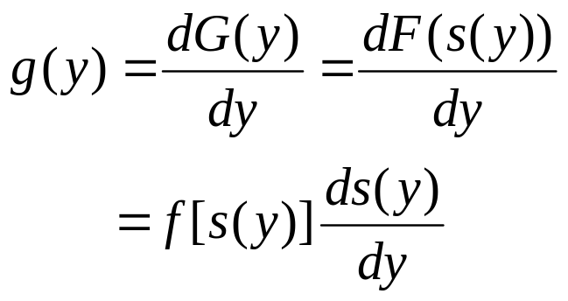
Direct Derivation of p.d.f.
Suppose Y=r(X) where r is continuous, and X lies in a certain interval (a,b) over which the function r(x) is strictly increasing.
  Then r is a one-to-one function which maps (a,b) to (α,β) . It has an inverse function X=s(Y).
  For any y such that α<y<β,
  Suppose s is differentiable over (α,β), then

Slide 6
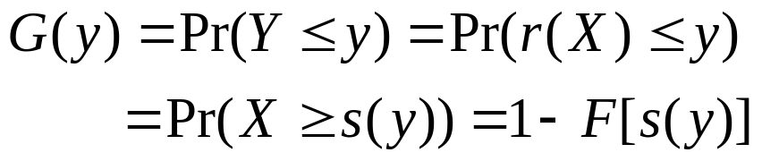
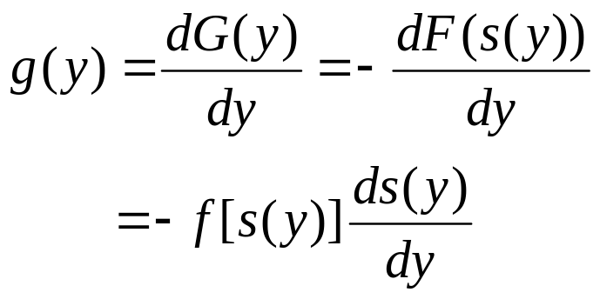
Suppose Y=r(X) where r is continuous, and X lies in a certain interval (a,b) over which the function r(x) is strictly decreasing.
  Then r is a one-to-one function which maps (a,b) to (α,β) . It has an inverse function X=s(Y).
  For any y such that α<y<β,
  Suppose s is differentiable over (α,β), then

Slide 7
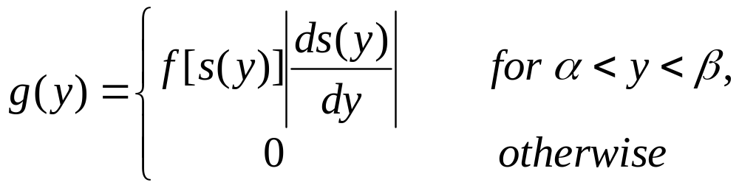
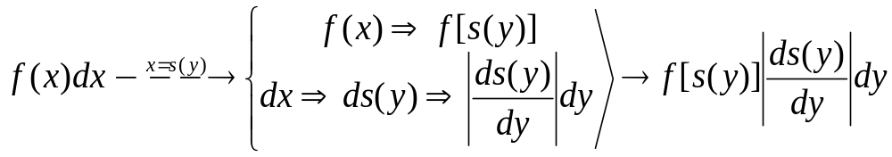
Theorem. Let X be a random variable for which the p.d.f. is f and Pr(a<X<b)=1. Let Y=r(X), and suppose that r(x) is continuous and either strictly increasing or strictly decreasing for a<x<b. Suppose also that r(x) maps a<x<b to α<y<β, and let X=s(Y) be the inverse function for α <Y<β. Then the p.d.f. of Y is specified by

Slide 8
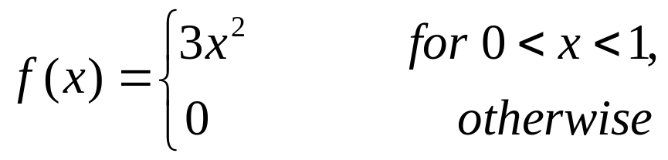

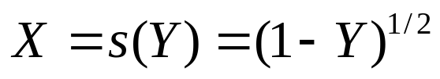
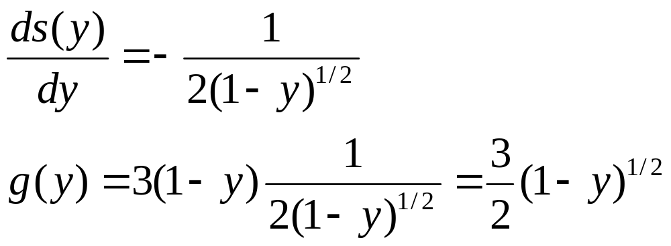
Example
Suppose X has a p.d.f.
What is the p.d.f. of ?
Solution: Y is a continuous, strictly decreasing function for 0<X<1, with range 0<Y<1. The inverse function is for 0<Y<1.

Slide 9
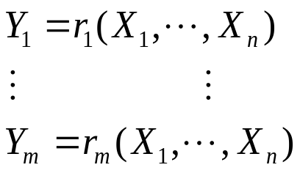
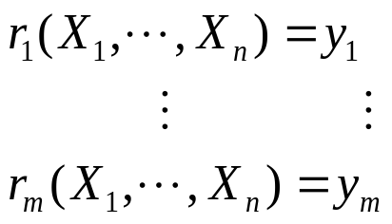
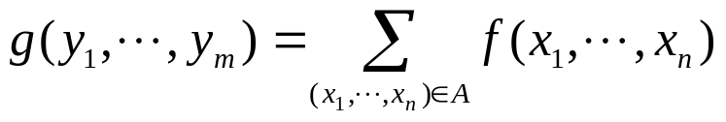
Functions of Two or More Random Variables
Suppose X1,...,Xn have a discrete joint distribution with p.f. f, and m functions Y1,...,Ym of these n random variables are:
  For any given values y1,...,ym, let A denote the set of all points (x1,...,xn) such that
  Then the joint p.f. g of Y1,...,Ym is:
Notes:
BMI=weight (in kg)/[height (in m)]^2
BMI<18.5 underweight
18.5-24.9 normal
25.0-29.9 overweight
30.0 and above obese
If we know the joint distribution of height and weight for certain population, can we infer the distribution of BMI in the population?
If we know the joint distribution of the number of years of education and annual income for certain population, can we infer the distribution of (annual income/years of education)?

Slide 10


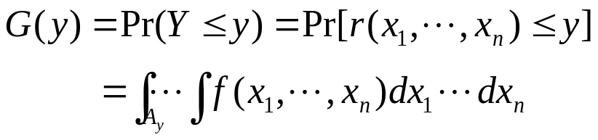
Variables with A Continuous
Joint Distribution
Suppose the joint p.d.f. of X1,...,Xn is f(x1,...,xn) and Y=r(X1,...,Xn). For any given value y, let Ay be the subset of containing all points (x1,...,xn) such that
. Then
If the distribution of Y is also continuous, then the p.d.f. of Y can be found by differentiating the d.f. G(y).

Slide 11

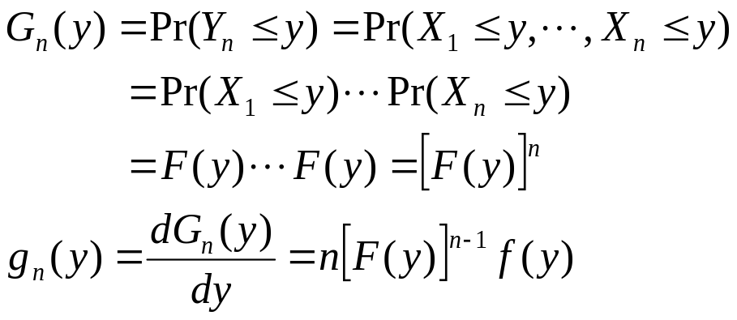
The Distribution of Maximum and Minimum Values in a Random Sample
Suppose X1,...,Xn form a random sample of size n from a distribution with p.d.f. f and d.f. F. Consider

Slide 12

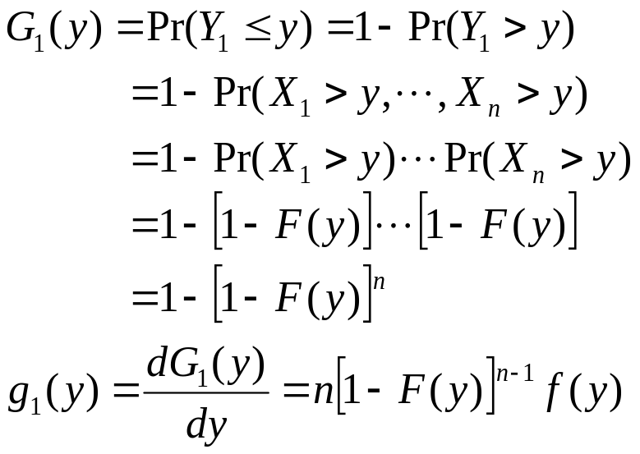
Consider

Slide 13
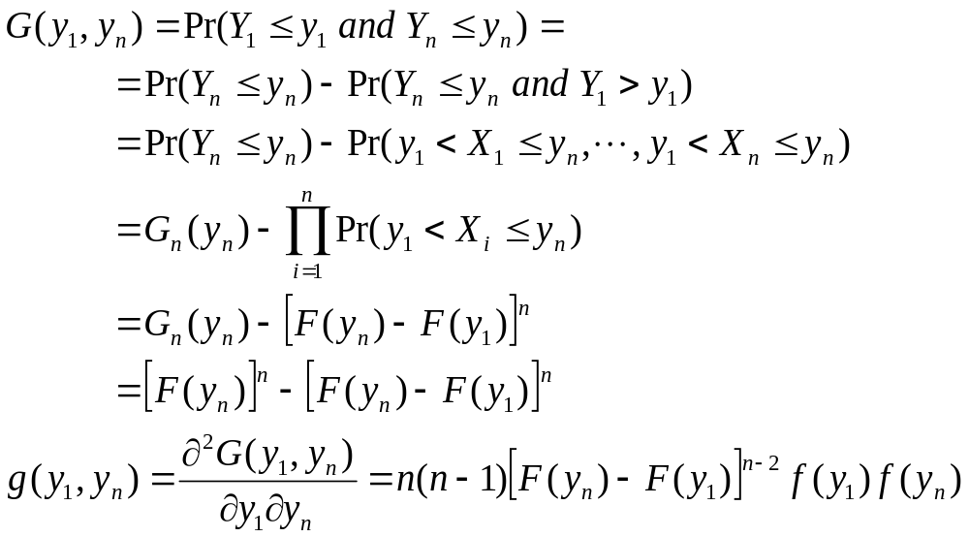
Suppose we want to find the joint distribution of and

Slide 14
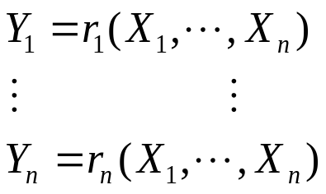

Transformation of A Multivariate p.d.f.
Suppose X1,...,Xn have a continuous joint distribution with joint p.d.f. f, and n new random variables Y1,...,Yn are defined by:
Suppose is the support for X1,...,Xn, the image under the transformation is T. Assume that the transformation from S to T is a one-to-one transformation.

Slide 15
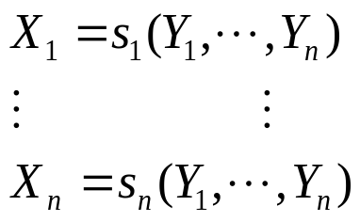


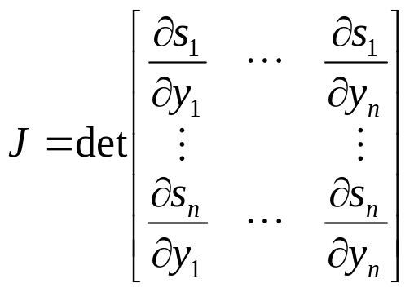
We can get the inverse of the transformation:
Suppose each partial derivative exists at every point . The Jacobian of the transformation can be constructed:
The joint p.d.f. g of Y1,...,Yn can be derived:

Slide 16
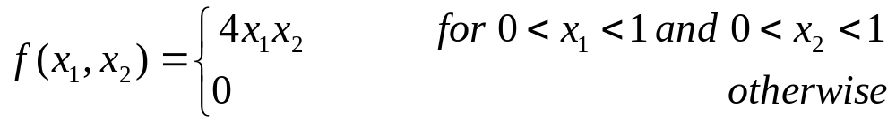
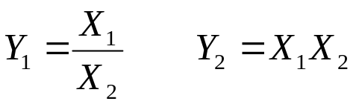
Example
Suppose X1 and X2 have a continuous joint distribution with p.d.f.
What is the joint p.d.f. of Y1 and Y2?

Slide 17
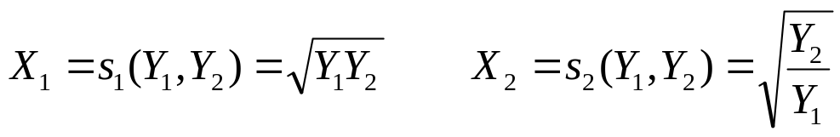
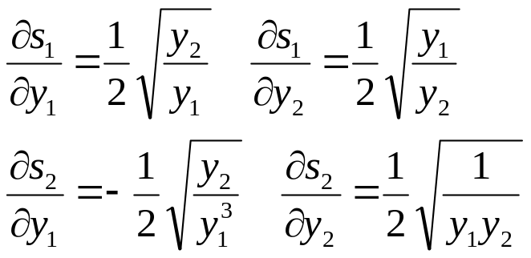
  The inverse of the transformation is
  S={(x1,x2): 0<x1<1, 0<x2<1}
  T={(y1,y2): y1>0, y2>0, y1y2<1, y2/y1<1}
  We have

Slide 18
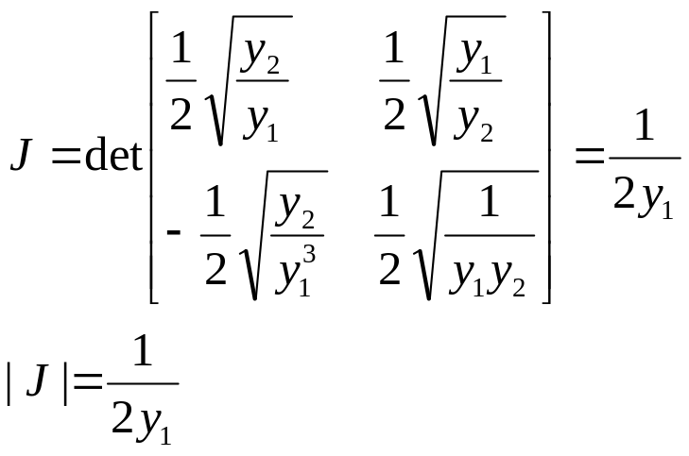
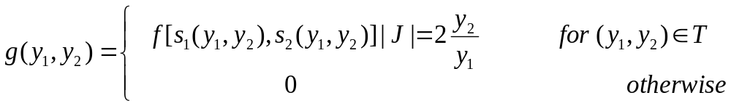
The Jacobian is
The p.d.f. of Y1 and Y2 is:

Slide 19
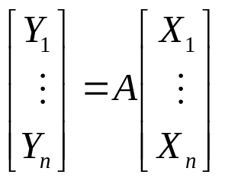

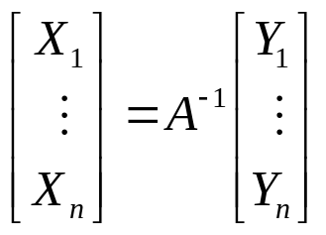

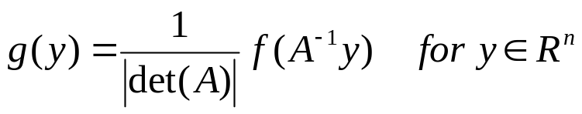
Linear Transformation
Let A be a nxn matrix, suppose Y1,...,Yn are defined by:
If A is nonsingular, then the matrix exists.
The inverse transformation is:
The Jacobian J is
The p.d.f. of Y1,...,Yn is

Slide 20
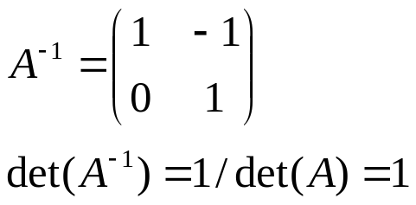
The Sum of Two Random Variables
Suppose X1 and X2 have a given joint p.d.f. f, and we want to find the p.d.f for Y=X1+X2.
  Let Z=X2, then the transformation from X1 and X2 to Y and Z will be a one-to-one linear transformation.
  The inverse transformation is
  X1=Y-Z, X2=Z
  The matrix of coefficients of this transformation is

Slide 21
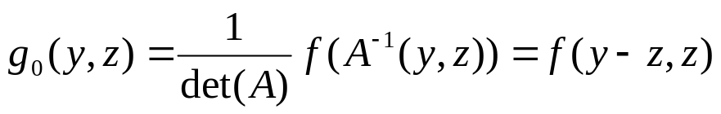
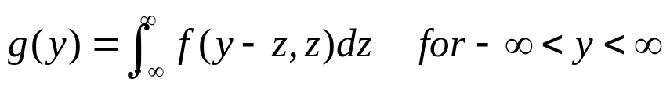
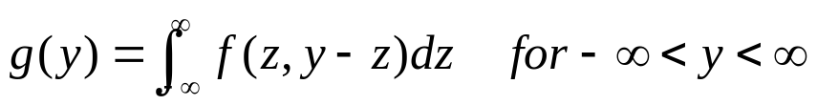
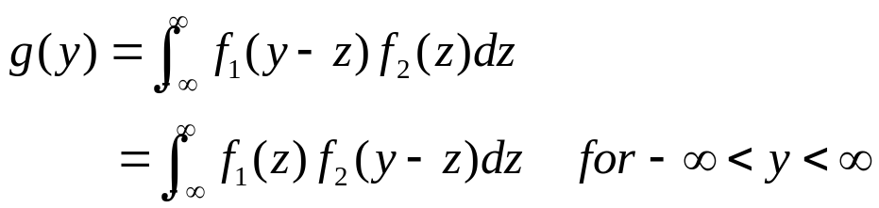
  The joint p.d.f. of Y and Z is:
  The marginal p.d.f. g of Y can be obtained by:
  Similarly, if we let Z=X1, we can have
  If X1 and X2 are independent random variables with marginal p.d.f.’s f1 and f2, we can have

Slide 22
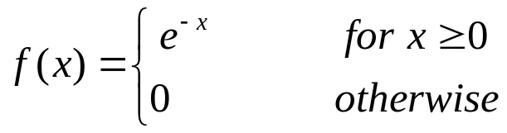

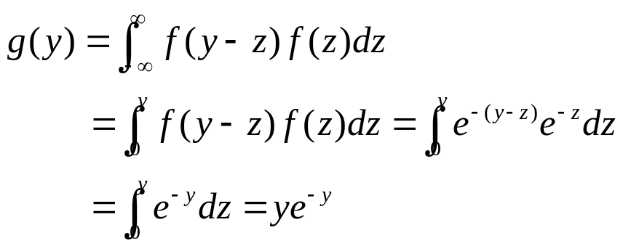
Example 3.9.3
Suppose that X1 and X2 are i.i.d. random variables and the p.d.f. for each is:
What is the p.d.f. g of Y=X1+X2?
Solution: For
g(y)=0 for y<0.

Slide 23
The Range
Suppose X1,...,Xn form a random sample of size n from a distribution with p.d.f. f and d.f. F. and .
W=Yn-Y1 is called the range of the sample. What is the p.d.f. of W?
Solution: We already derived the joint p.d.f.
g(y1,yn) of Y1 and Yn. If we let Z=Y1,
then the transformation from Y1 and Yn
to W and Z will be a one-to-one linear
transformation.
Notes:
Refer back to page 13.

Slide 24


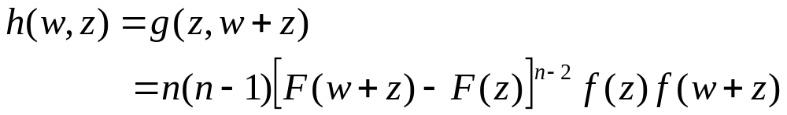
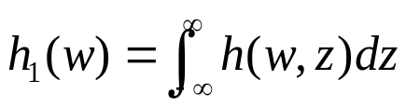
The inverse transformation is
Y1=Z
Yn=W+Z
with |J|=1. The joint p.d.f. of W and Z for and is
The marginal p.d.f. of W is

Slide 25
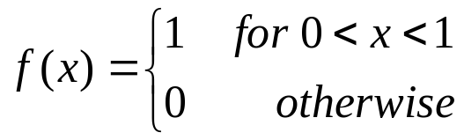
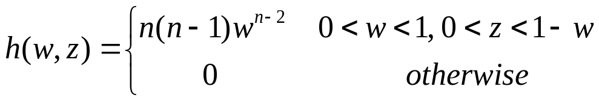
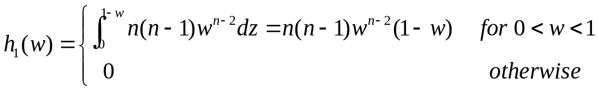
Example
Suppose that n variables X1,…,Xn form a random sample from a uniform distribution on the interval [0,1]. What is the p.d.f. of the range of the sample?
Solution:
F(x)=x for 0<x<1.
So

